Slide 1
Taylor Swift Traveling Salesperson Problem
Linear Programming Final Project
Madison Poore, Luke Anderson

Slide 2
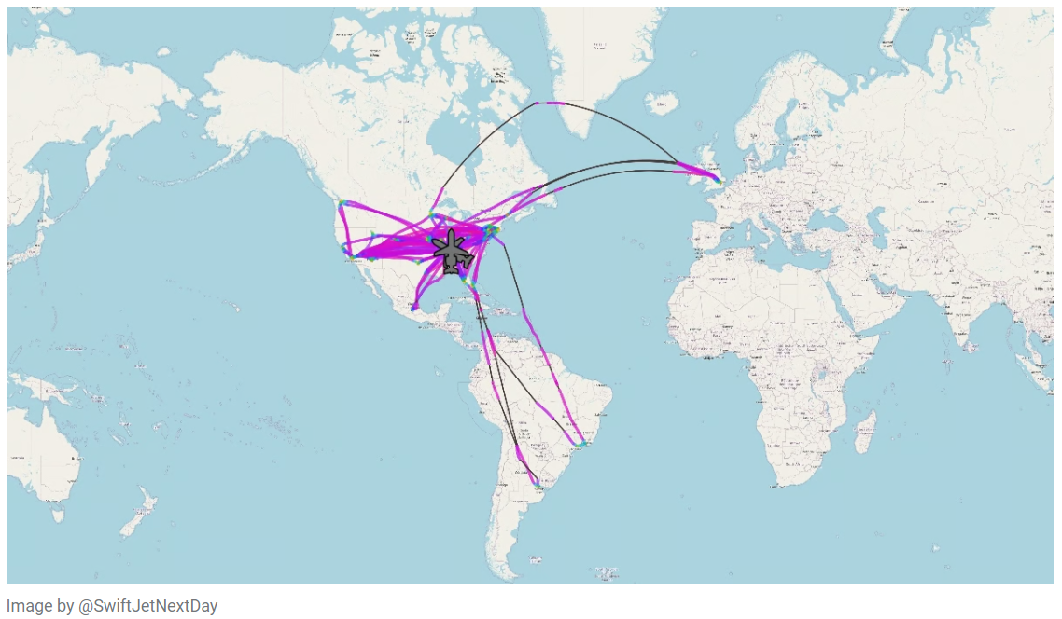
Motivation
Taylor Swift’s inefficient travel in 2023 sparked lots of frustration due to excessive carbon emissions.
Research Question: Can we leverage the TSP in order to optimize Taylor Swift’s travel within a given period of time?

Slide 3

Simplifying Assumptions
Taylor Swift is only travelling for her tours and she performs all shows consecutively (without returning home to Nashville in between).
Flight paths follow the shortest distance from City A to City B.
There is a direct conversion between distance traveled and carbon emissions.
One mile traveled in Taylor Swift’s Dassault Falcon 7X contributes 0.002 tons of CO2.

Slide 4
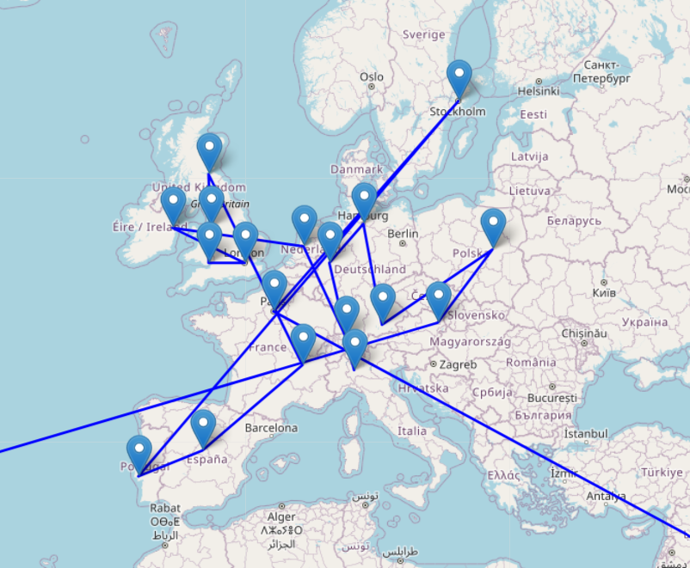
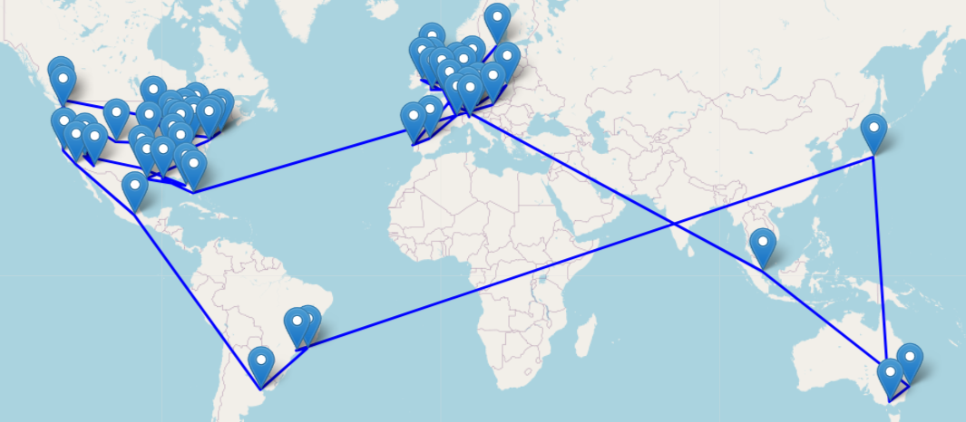
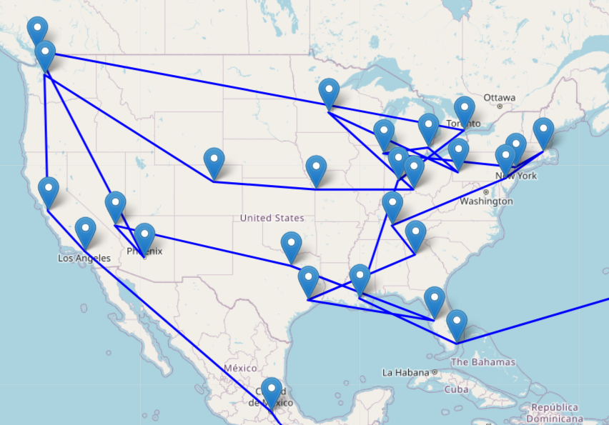
Unoptimized Tour Map in 2023
64,264 miles traveled, 128.5 tons CO2

Slide 5
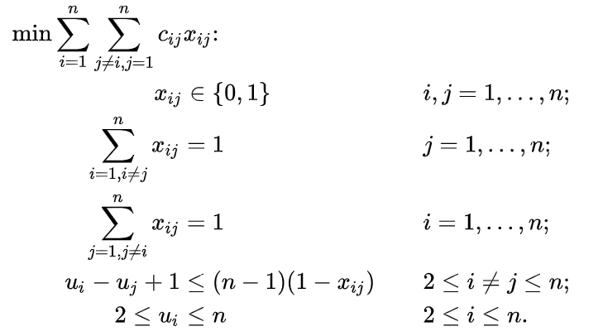
Method 1: Linear Programming
Miller-Tucker-Zemlin formulation of the TSP
c: Represents cost (in this case, carbon emissions per mile)
x: Represents whether or not there is an edge between city i and city j.
u_{i} < u_{j} means you visit city i before city j
Implemented via Gurobi, but only for small problems (less than 50 cities)

Slide 6
Results
Small examples of MTZ will result in optimality.
Our instance has 55 cities, which has too many constraints to find optimality in Gurobi.
So, we cannot improve Taylor Swift’s tour schedule using MTZ formulation.

Slide 7
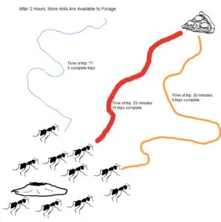
Method 2: Ant Colony Optimization
ACO is an optimization algorithm inspired by the behavior of ants.
Ants move randomly between cities leaving a pheromone trail behind them, if the ant finds a good solution it signals back to other ants to follow the path.
Does not guarantee an optimal solution, but if tuned properly can get within 95% of optimality.

Slide 8
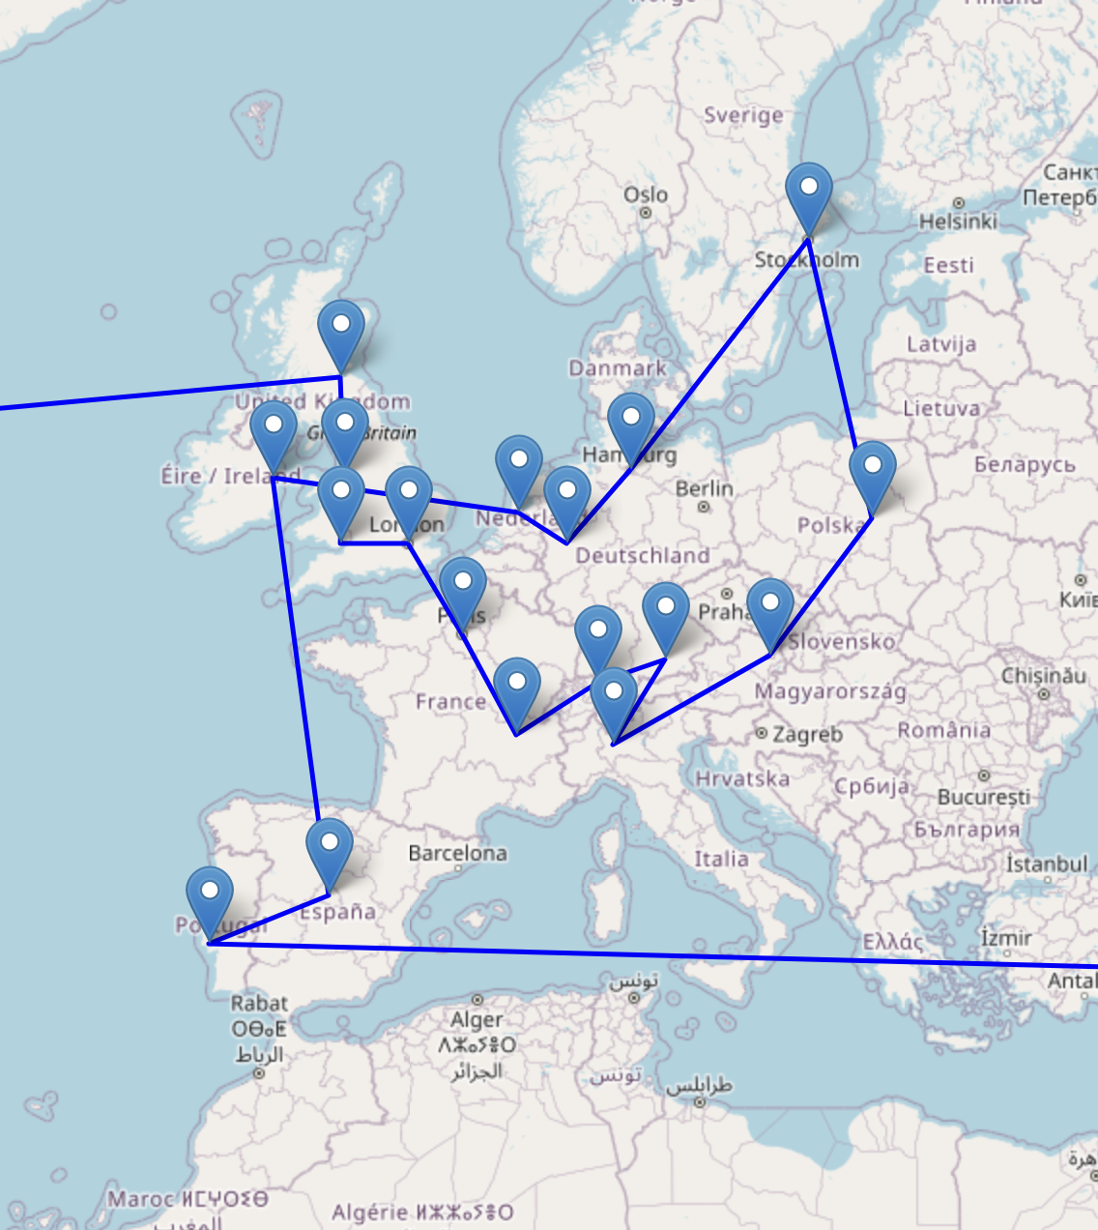
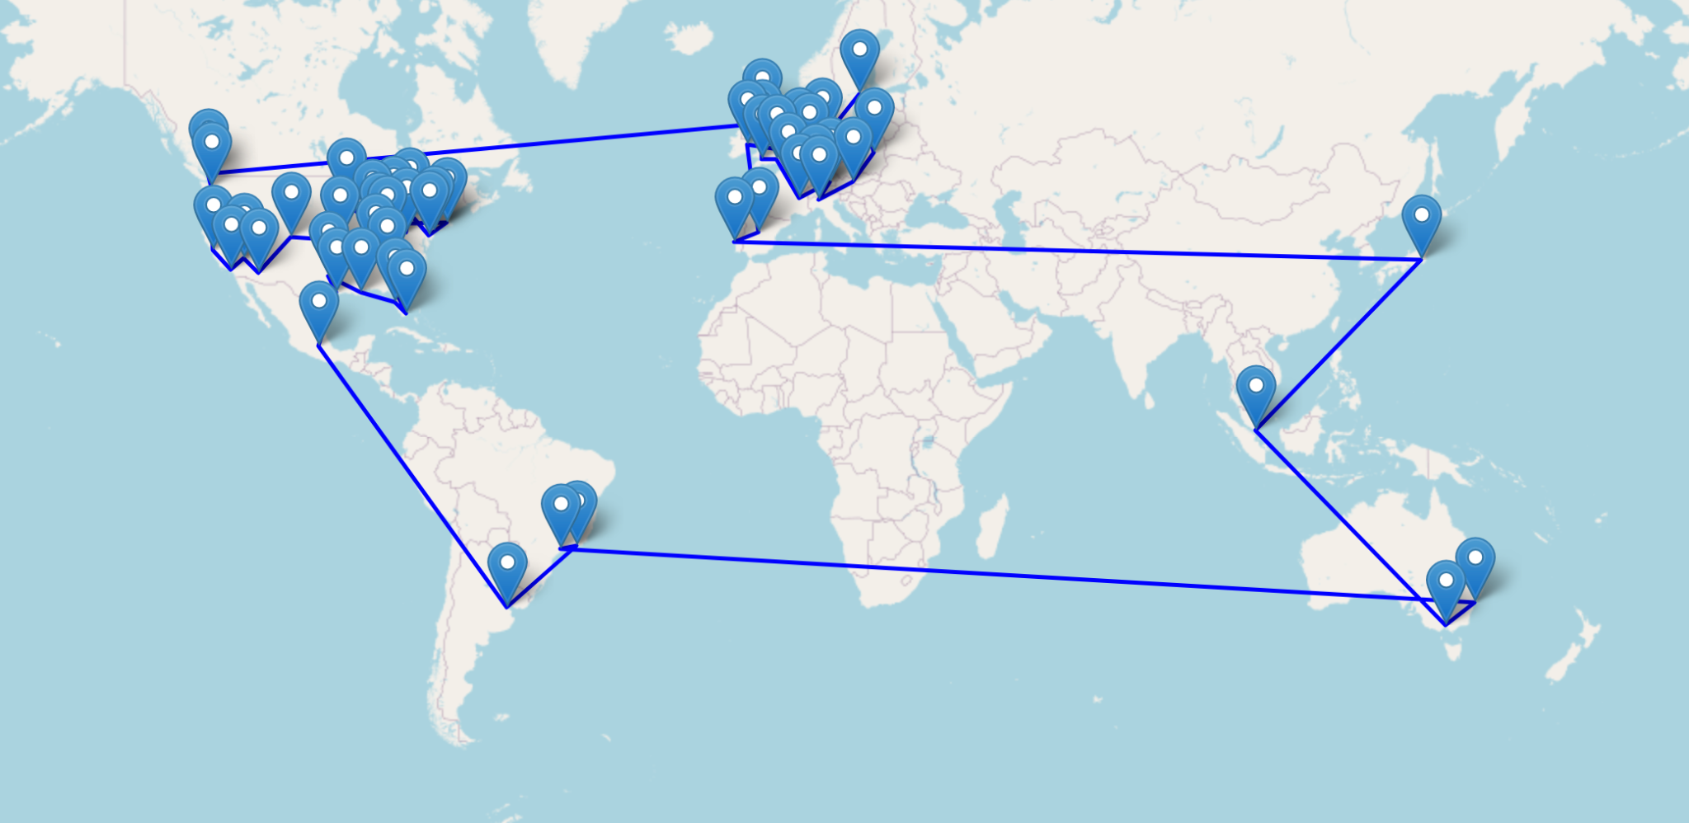
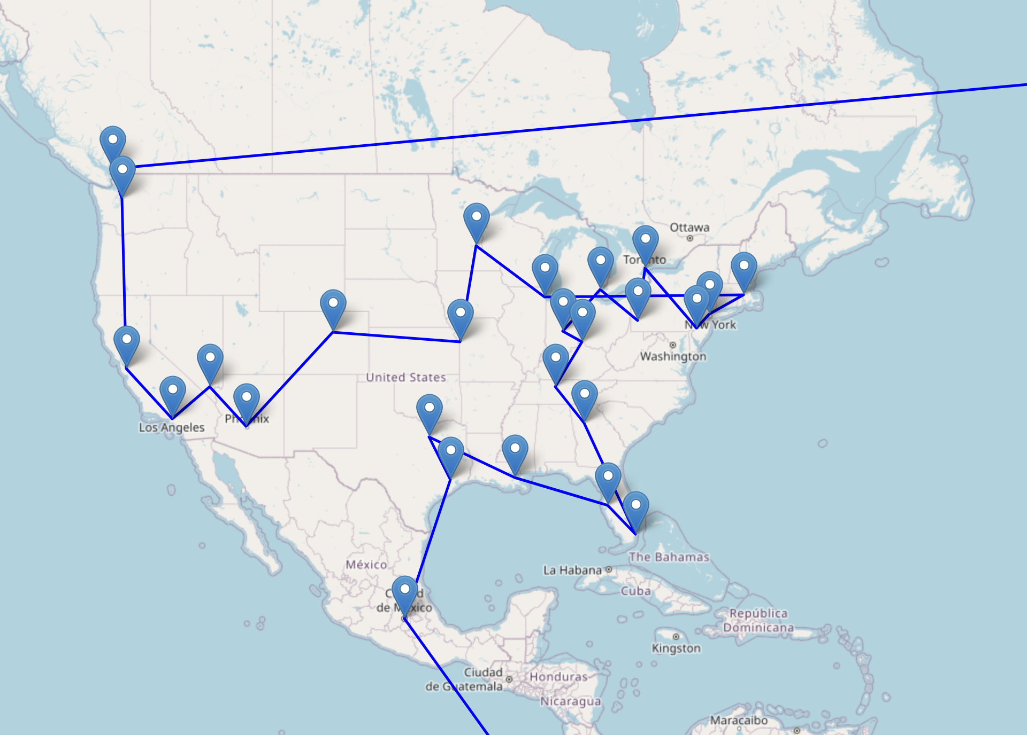
Results
Total distance: 47,260 miles (Original 64,264)
CO2 emissions down to 94.5 from 128.5 tons

Slide 9
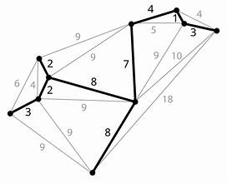
Method 3: Networkx Graph Representation Solver
Networkx is a graph based python library.
Nodes represent cities, edges represent carbon emissions
The default behavior is to use the Christofides algorithm (Heuristic Algorithm)
Christofides Algorithm
Find Minimum Spanning Tree
The Handshake Lemma says the number of vertices with odd degree are even. Pair them.
Combine edges of MST and handshake pairs
Form Eulerian Circuit in H.

Slide 10
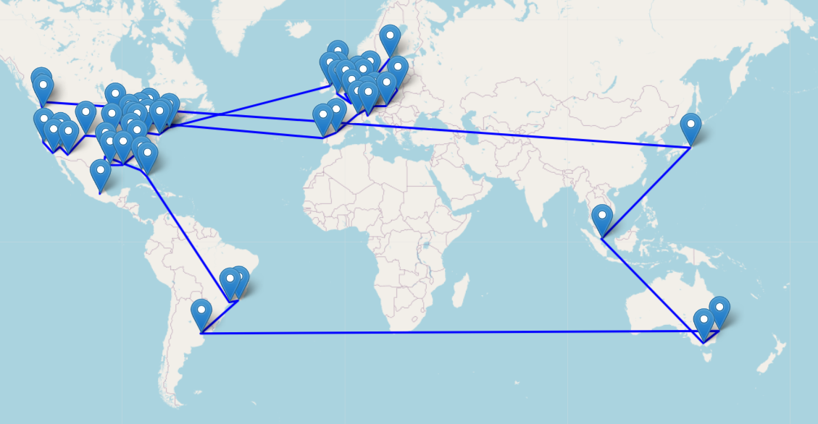
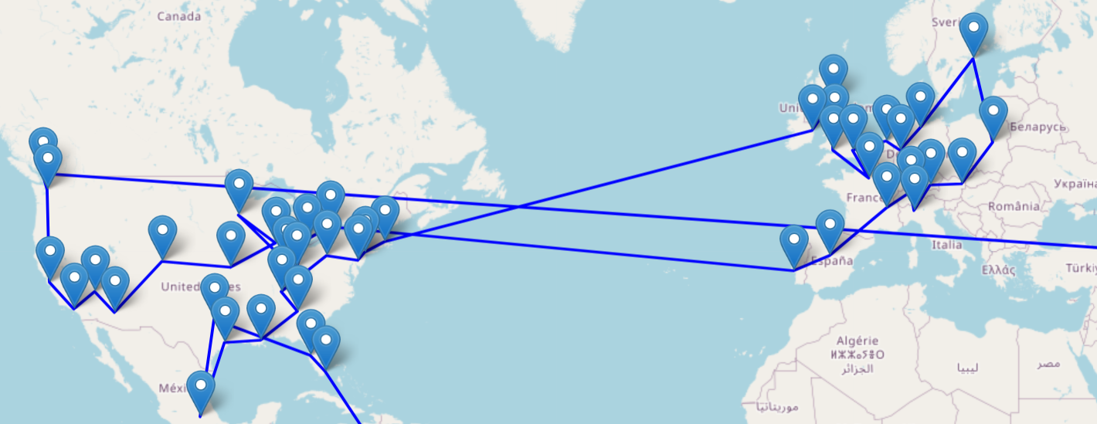
Results
91.08 tons of CO2 emissions and 45,540 miles
Improved from 128.5 tons CO2 and 64,264 miles

Slide 11
Conclusions
Even with a suboptimal solution it is possible to greatly reduce Taylor Swift’s total carbon emissions.
The NetworkX Graph Representation Solver leverages minimum spanning trees in order to get the best results for Taylor Swift’s tour schedule that this study encountered.

Slide 12
Follow Up
Get full Gurobi license and compare results to ACO and NetworkX
Change model assumptions to more closely reflect reality
Include visits home, chiefs games, etc…
Adjust distance calculation to allow for trans-Pacific travel

Slide 13
References
Christofides, Nicos. “Worst-Case Analysis of a New Heuristic for the Travelling Salesman Problem - Operations Research Forum.” SpringerLink, Springer International Publishing,3Mar.2022,link.springer.com/article/10.1007/s43069-021-00101-z.
“Traveling_salesman_problem.” Traveling_salesman_problem - NetworkX 3.4.2 Documentation, networkx.org/documentation/stable/reference/algorithms/generated/networkx.algorithms.approximation.traveling_salesman.traveling_salesman_problem.html. Accessed 18 Nov. 2024.
Ramamurthy, Induraj. “Implementing Ant colony optimization in python- solving Traveling salesman problem”, Medium. https://induraj2020.medium.com/implementation-of-ant-colony-optimization-using-python-solve-traveling-salesman-problem-9c14d3114475

